Slide 1
The Chi-Square Statistic Tests for Goodness of Fit and Independence
Chapter 17

Slide 2
Parametric and Nonparametric Tests
All the statistical tests we have examined thus far are designed to test hypotheses about specific population parameters.
Because these tests all concern parameters and require assumptions about parameters, they are called parametric tests.
Another general characteristic of parametric tests is that they require a numerical score for each individual in the sample.

Slide 3
Parametric and Nonparametric Tests (cont'd.)
Often, researchers are confronted with experimental situations that do not conform to the requirements of parametric tests.
In these situations, it may not be appropriate to use a parametric test.
When the assumptions of a test are violated, the test may lead to an erroneous interpretation.
There are several hypothesis-testing techniques that provide alternatives to parametric tests.
These alternatives are called nonparametric tests.

Slide 4
Parametric and Nonparametric Tests (cont'd.)
Occasionally, you have a choice between using a parametric and a nonparametric test.
In most situations, the parametric test is preferred because it is more likely to detect a real difference or a real relationship.

Slide 5
Parametric and Nonparametric Tests (cont'd.)
However, there are situations for which transforming scores into categories might be a better choice.
It may be simpler to obtain category measurements.
The original scores may violate some of the basic assumptions that underlie certain statistical procedures.

Slide 6
Parametric and Nonparametric Tests (cont'd.)
The original scores may have unusually high variance.
Occasionally, an experiment produces an undetermined, or infinite, score when, for example, a participant fails to solve a problem. Although there is no absolute number that can be assigned, you can say that the participant is in the highest category, and then classify the other scores according to their numerical values.

Slide 7
The Chi-Square Test for Goodness-of-Fit
The chi-square test for goodness of fit uses sample data to test hypotheses about the shape or proportions of a population distribution.
The test determines how well the obtained sample proportions fit the population proportions specified by the null hypothesis.

Slide 8
The Chi-Square Test for Goodness-of-Fit (cont'd.)
The null hypothesis specifies the proportion of the population that should be in each category.
The null hypothesis often states that there is no preference among the different categories. In this case, H₀ states that the population is divided equally among the categories.
The null hypothesis can state that the proportions for one population are not different from the proportions than are known to exist for another population.

Slide 9
The Chi-Square Test for Goodness-of-Fit (cont'd.)
The data for a chi-square test are remarkably simple.
You just select a sample of n individuals and count how many are in each category.
The resulting values are called observed frequencies.
The symbol for observed frequency is f_{o}.

Slide 10
Sample Distributions
Notes:
FIGURE 17.1 Distribution of eye colors for a sample of n = 40 individuals. The same frequency distribution is shown as a bar graph, as a table, and with the frequencies written in a series of boxes.

Slide 11
The Chi-Square Test for Goodness-of-Fit (cont'd.)
The general goal of the chi-square test for goodness of fit is to compare the data (the observed frequencies) with the null hypothesis.
The problem is to determine how well the data fit the distribution specified in H₀.
The first step in the chi-square test is to construct a hypothetical sample that represents how the sample distribution would look if it were in perfect agreement with the proportions stated in the null hypothesis.

Slide 12
The Chi-Square Test for Goodness-of-Fit (cont'd.)
The expected frequency for each category is the frequency value that is predicted from the proportions in the null hypothesis and the sample size (n).
The expected frequencies define an ideal, hypothetical sample distribution that would be obtained if the sample proportions were in perfect agreement with the proportions specified in the null hypothesis.

Slide 13
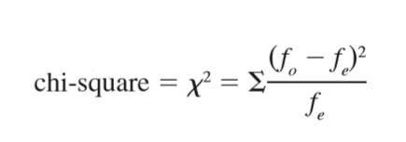
The Chi-Square Test for Goodness-of-Fit (cont'd.)
The chi-square statistic simply measures how well the data (f_{o}) fit the hypothesis (f_{e}). The symbol for the chi-square statistic is χ² and the formula is given by

Slide 14
The Chi-Square Test for Goodness-of-Fit (cont'd.)
As the formula indicates, the value of chi-square is computed by the following steps.
Find the difference between f_{o} (the data) and f_{e} (the hypothesis) for each category.
Square the difference. This ensures that all values are positive.
Next, divide the squared difference by f_{e}.
Finally, sum the values from all the categories.

Slide 15
The Chi-Square Distribution and Degrees of Freedom
To decide whether a particular chi-square value is “large” or “small,” we must refer to a chi-square distribution.
This distribution is the set of chi-square values for all the possible random samples when H₀ is true.
The chi-square distribution is a theoretical distribution with well-defined characteristics.
The formula for chi-square involves adding squared values, so you can never obtain a negative value. Thus, all chi-square values are zero or larger.

Slide 16
The Chi-Square Distribution and Degrees of Freedom (cont’d.)
When H₀ is true, you expect the data (f_{o} values) to be close to the hypothesis (f_{e} values). Thus, we expect chi-square values to be small when H₀ is true.
These two factors suggest that the typical chi-square distribution will be positively skewed.
For the goodness-of-fit test, the degrees of freedom are determined by
df = C – 1
where C is the number of categories.

Slide 17
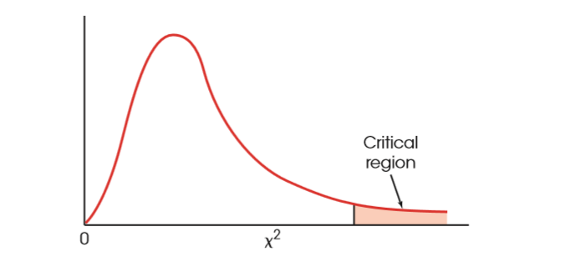
Chi-Square Distribution
Notes:
FIGURE 17.2 Chi-square distributions are positively skewed. The critical region is placed in the extreme tail, which reflects large chi-square values.

Slide 18
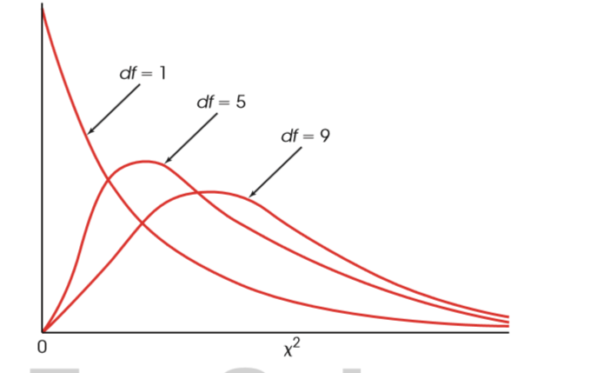
Chi-Square Distributions for Different Values of df
Notes:
FIGURE 17.3 The shape of the chi-square distribution for different values of df. As the number of categories increases, the peak (mode) of the distribution has a larger chi-square value.

Slide 19
Locating the Critical Region for a Chi-Square Test
To determine whether a particular chi-square value is significantly large, you must consult a chi-square distribution table.
The first column lists df values for the chi-square test, and the top row of the table lists pro- portions (alpha levels) in the extreme right-hand tail of the distribution.
The numbers in the body of the table are the critical values of chi-square.

Slide 20
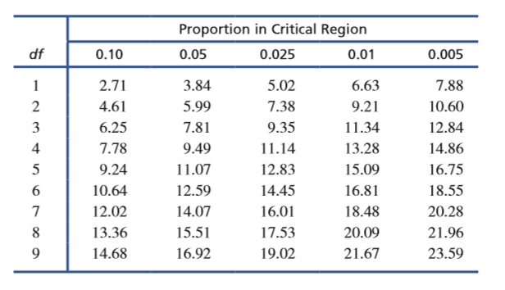
Table of Values for Chi-Square Distribution
Notes:
TABLE 17.2 A portion of the table of critical values for the chi-square distribution.

Slide 21
The Chi-Square Test for Independence
The chi-square test for independence uses the frequency data from a sample to evaluate the relationship between two variables in the population.
Each individual in the sample is classified on both of the two variables, creating a two-dimensional frequency distribution matrix.
The frequency distribution for the sample is then used to test hypotheses about the corresponding frequency distribution in the population.

Slide 22
The Chi-Square Test for Independence (cont'd.)
The null hypothesis for the chi-square test for independence states that the two variables being measured are independent.
This general hypothesis can be expressed in two different conceptual forms, each viewing the data and the test from slightly different perspectives.
The data are viewed as a single sample with each individual measured on two variables. The null hypothesis states that there is no relationship between the two variables.

Slide 23
The Chi-Square Test for Independence (cont'd.)
The data are viewed as two (or more) separate samples representing two (or more) populations or treatment conditions. The goal of the chi-square test is to determine whether there are significant differences between the populations. The null hypothesis states that there is no difference between the two populations.

Slide 24
The Chi-Square Test for Independence (cont'd.)
Two variables are independent when there is no consistent, predictable relationship between them.
In this case, the frequency distribution for one variable is not related to (or dependent on) the categories of the second variable.
As a result, when two variables are independent, the frequency distribution for one variable will have the same shape (same proportions) for all categories of the second variable.

Slide 25
The Chi-Square Test for Independence (cont'd.)
The chi-square test for independence uses the same basic logic that was used for the goodness-of-fit test.
First, a sample is selected, and each individual is classified or categorized.
Because the test for independence considers two variables, every individual is classified on both variables, and the resulting frequency distribution is presented as a two-dimensional matrix.

Slide 26
The Chi-Square Test for Independence (cont'd.)
As before, the frequencies in the sample distribution are called observed frequencies and are identified by the symbol f_{o}.
The next step is to find the expected frequencies, or f_{e} values, for this chi-square test.
As before, the expected frequencies define an ideal hypothetical distribution that is in perfect agreement with the null hypothesis.
Once the expected frequencies are obtained, we compute a chi-square statistic to determine how well the data fit the null hypothesis.

Slide 27
Expected Frequencies
Notes:
TABLE 17.6 Expected frequencies corresponding to the data in Table 17.4. (This is the distribution predicted by the null hypothesis.)

Slide 28
The Chi-Square Test for Independence (cont'd.)
The chi-square test of independence uses exactly the same chi-square formula as the test for goodness of fit:

Slide 29
The Chi-Square Test for Independence (cont'd.)
If R is the number of rows and C is the number of columns, and you remove the last column and the bottom row from the matrix, you are left with a smaller matrix that has C – 1 columns and R – 1 rows.
The number of cells in the smaller matrix determines the df value.
df = (R – 1) (C – 1)

Slide 30
Effect Size for the Chi-Square Tests
Tests of significance are influenced not only by the size or strength of the treatment effects but also by the size of the samples.
As a result, even a small effect can be statistically significant if it is observed in a very large sample.
Because a significant effect does not necessarily mean a large effect, it is generally recommended that the outcome of a hypothesis test be accompanied by a measure of the effect size.

Slide 31
Cohen’s w
Cohen introduced a statistic called w that provides a measure of effect size for either of the chi-square tests.
The formula for Cohen’s w is very similar to the chi-square formula but uses proportions instead of frequencies.

Slide 32
Cohen’s w (cont’d.)
In the formula, the P_{o} values are the observed proportions in the data and are obtained by dividing each observed frequency by the total number of participants.
observed proportion = P_{o} = f_{o} / n
Similarly, the P_{e} values are the expected proportions that are specified in the null hypothesis.

Slide 33
Cohen’s w (cont’d.)
The formula instructs you to:
Compute the difference between the observed proportion and the expected proportion for each cell (category).
For each cell, square the difference and divide by the expected proportion.
Add the values from step 2 and take the square root of the sum.

Slide 34
Cohen’s w (cont’d.)
Cohen’s also suggested guidelines for interpreting the magnitude of w, with values near 0.10 indicating a small effect, 0.30 a medium effect, and 0.50 a large effect.

Slide 35
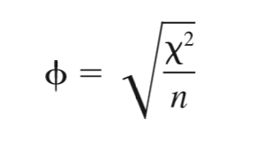
The Phi-Coefficient and Cramér’s V
It is possible to compute the correlation phi (ϕ) in addition to the chi-square hypothesis test for the same set of data.
Because phi is a correlation, it measures the strength of the relationship and thus provides a measure of effect size.
The value for the phi-coefficient can be computed directly from chi-square by the following formula:

Slide 36
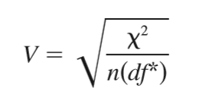
The Phi-Coefficient and Cramér’s V (cont’d.)
When the chi-square test involves a matrix larger than 2 × 2, a modification of the phi-coefficient, known as Cramér’s V, can be used to measure effect size.
For Cramér’s V, the value of df* is the smaller of either (R – 1) or (C – 1).

Slide 37
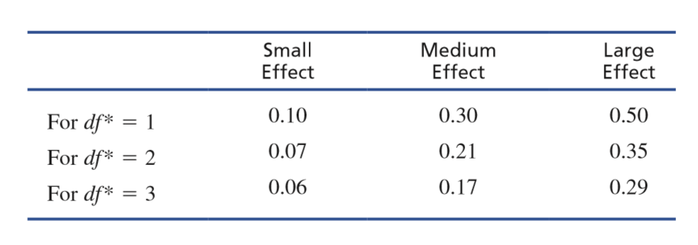
Standards for Interpreting Cramér’s V
Notes:
TABLE 17.10 Standards for interpreting Cramér’s V as proposed by Cohen (1988).

Slide 38
Assumptions for the Chi-Square Tests
To use a chi-square test for goodness of fit or a test of independence, several conditions must be satisfied. For any statistical test, violation of assumptions and restrictions casts doubt on the results.
Independence of Observations: This is not to be confused with the concept of independence between variables, as seen in the chi-square test for independence.
One consequence of independent observations is that each observed frequency is generated by a different individual.

Slide 39
Assumptions for the Chi-Square Tests (cont'd.)
Size of expected frequencies
A chi-square test should not be performed when the expected frequency of any cell is less than 5.
The chi-square statistic can be distorted when f_{e} is very small.

